Slide 1
AdaBoost Algorithm
AdaBoost (Adaptive Boosting) is a very popular boosting technique that aims at combining multiple weak classifiers to build one strong classifier.
A single classifier may not be able to accurately predict the class of an object, but when we group multiple weak classifiers with each one progressively learning from the others' wrongly classified objects, we can build one such strong model.
A weak classifier is one that performs better than random guessing, but still performs poorly at designating classes to objects. For example, a weak classifier may predict that everyone above the age of 40 could not run a marathon but people falling below that age could. Now, you might get above 60% accuracy, but you would still be misclassifying a lot of data points!

Slide 2
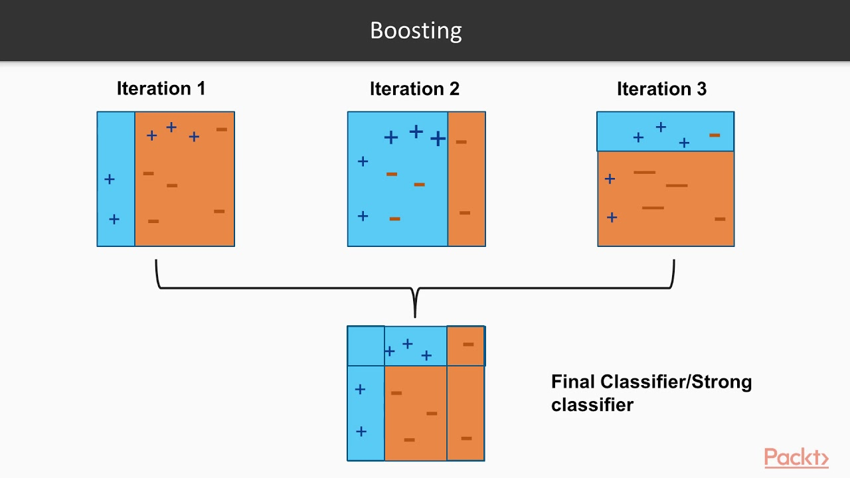

Slide 3
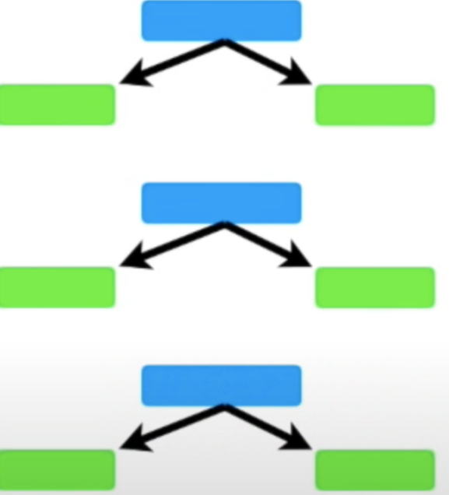
Stumps 1.Stumps are technically weak learners. A tree with just one node and two leaves is called a Stump Stump

Slide 4
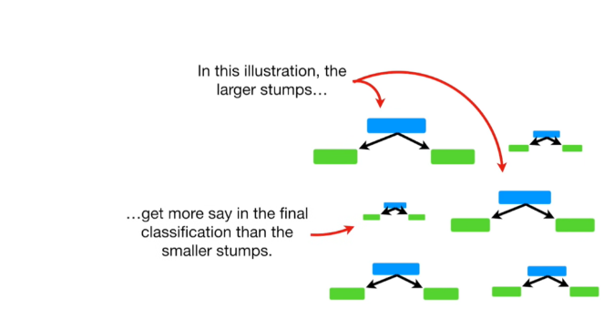
2. In a Random Forest, each tree has an equal vote on the final classification. In contrast, in a Forest of Stumps made with AdaBoost, some stumps get more say in the final classification than others.

Slide 5
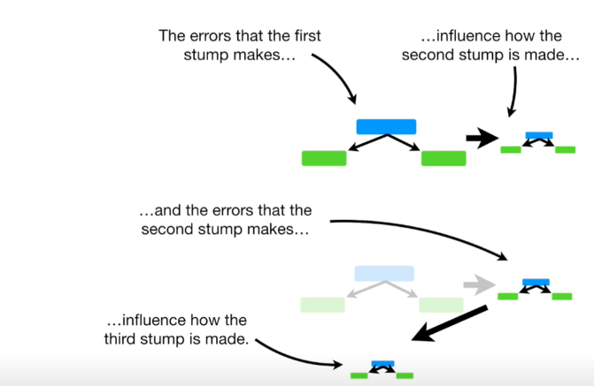
3. Lastly, in a Random Forest, each decision tree is made independently of the others. In contrast, in a Forest of Stumps made with AdaBoost, order is important. Each Stump is made by taking the previous Stump’s mistake into account.

Slide 6
Conclusion
Adaboost algorithm is an exceptional method to boost up the performance of a machine learning model by combining all the weak learners together to form a strong predictor.

